Slide 1
LGBT Role Models
www.lgbtyouth.org.uk
Notes:
To be completed after the assemblies on Generic LGBT Awareness.

Slide 2
What does the term ‘role model’ mean?
Notes:
As a starter activity, ask learners to define the term ‘role model’ in groups or pairs. Take feedback and ensure the main points are well understood.
This is a good definition:
a person whose behaviour, example, or success is or can be emulated by others, especially by younger people

Slide 3
This is my role model. Who’s yours?
Notes:
Replace the stick figure image with an image of your own personal role model. This can be whoever you wish and you should share your reasoning with learners.
Ask them who their role models are. This can be done in groups, pairs, or you could just ask learners to think about who their role models are independently. Ask for some example of who people selected, though it is advisable not to force people to share their role models if they don’t want to as it can be very personal.

Slide 4
Role models
Everyone needs role models.
This is especially true for LGBT people who don’t always see people like them positively represented in media (TV, films, books, etc.)
Who do you think would make good role models for LGBT people?
Notes:
Use the associated recording sheet to give groups 5-10 minutes to record as many LGBT people who would make good role models as they can. Reiterate that they need to make good role models.
Once they all have names in each column, as them to pick two or three people from each list as their ‘top’ role models. They should be able to explain why they think they would make good role models.
Facilitators should be mindful not to reinforce stereotypes and if the young people offer a name of someone who you don’t know is LGBT you can ask how they know and if it’s not clear, say you’ll find out if they are and you can Google it later, or email info@lgbtyouth.org.uk.
The following slides show role models selected by LGBT young people.

Slide 5
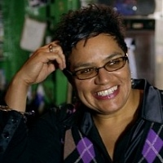
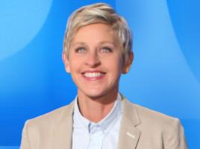
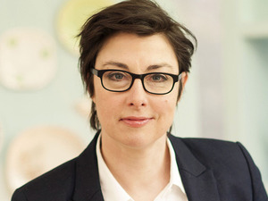
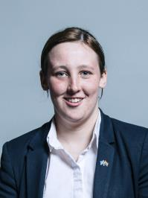
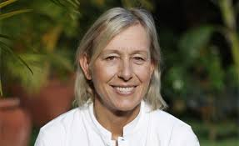
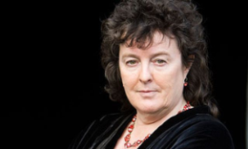
Notes:
Lesbians:
Jackie Kay – Scots Makar, Scotland’s official poet
Sue Perkins – comedian and TV presenter
Ellen Degeneres – actor, presenter, comedian, talk show host and generally lovely person
Martina Navratilova – tennis player, won Wimbledon 9 times!
Carol Ann Duffy – the Poet Laureate, the first woman, the first Scot and the first openly LGBT person to hold that role Mhairi Black – youngest MP in the House of Commons

Slide 6
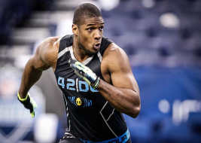
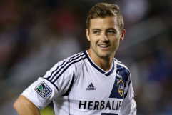
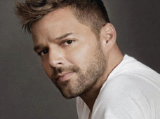
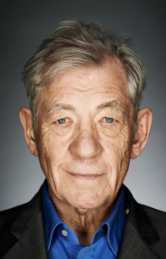
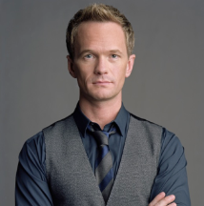
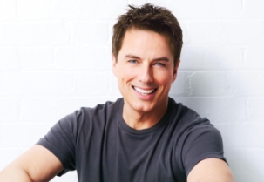
Notes:
Gay men:
Michael Sam – American footballer, the first to come out before the draft
Ricky Martin - Singer Robbie Rogers – football player who played for Leeds and LA Galaxy
Ian McKellan - Actor
Neil Patrick Harris – Actor / comedian
John Barrowman – Actor, presenter

Slide 7
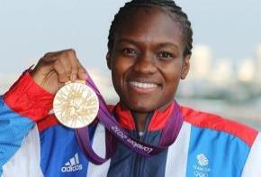
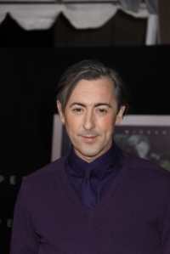
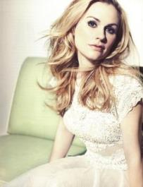
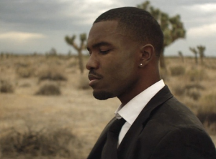
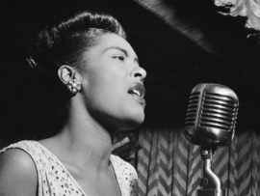
Notes:
Bisexuals:
Nicola Adams - Boxer
Alan Cumming - Actor
Anna Paquin - Actress
Frank Ocean – Singer songwriter Billie Holiday - Singer

Slide 8
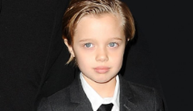
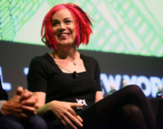
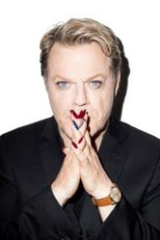
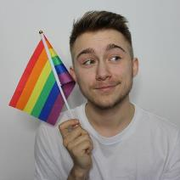
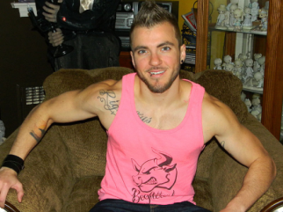
Notes:
Transgender people:
Laverne Cox - Actress
Lana Wachowski – sibling of Lilly Wachowski trans siblings who wrote Matrix, V for Vendetta
Balian Buschbaum – German Pole vaulter
John Pitt-Jolie – Angelina and Brad Pitts child
Aydian Dowling – 1st trans man on Gay Times
Alex Bertie – author and youtube vlogger
Eddie Izzard – comedian, marathon runner and campaigner

Slide 9
We want everyone in our school to feel safe, respected and included. If you have any questions about LGBT identities, or want to talk about being LGBT the best people to talk to are…
Notes:
Make changes to list the best people in your school to talk to about LGBT identities.

Slide 10
You can also access information about youth groups, coming out, information about LGBT identities and an anonymous online chat service at: lgbtyouth.org.uk
Notes:
Make changes to list the best people in your school to talk to about LGBT identities.

Slide 11
lgbtyouth.org.uk
info@lgbtyouth.org.uk

